Slide 1
SSZG 518: Database Design and Applications
Today’s Class
Transaction Management

Slide 2
Introduction
Time sharing systems executes more than one program at the same time by interleaving the execution of the programs
In DBMS, we consider transactions, not programs
A transaction is a database program that must be completed entirely in order to retain the consistency of the database; if the transaction cannot be completed, the database should remain at the same state as if the transaction hadn’t been executed at all
Concerned only with interleaved execution of transactions
If the database is initially in consistent state (or empty), a sequence of transactions would bring the database from one consistent state to another
Notes:
2
2

Slide 3
Assumptions and Basic Operations
A database is a set of data items accessed and modified by transactions
A transaction accesses or modifies the contents of a database
read_item(X) or R(X): Reads a database item X
write_item(X) or W(X): Writes a value into the database item X
Additional operations:
Commit - the transaction is successful and the data items value must be changed (if any) on the database permanently
Rollback/Abort - the transaction is not successful, do not change any of the data item values
BEGIN_TRANSACTION, END_TRANSACTION
DBMS may need UNDO and REDO for database recovery
Notes:
2
2

Slide 4
Transactions
Transactions are not just ordinary programs
Additional requirements are placed on transactions (and particularly their execution environment) that go beyond the requirements placed on ordinary programs.
Atomicity
Consistency
Isolation
Durability
ACID properties

Slide 5
ACID Properties
Atomicity
All-or-nothing property
Consistency
Each transaction is correct and does not violate database consistency
Isolation
Concurrent transactions do not interfere with each other
Durability
Once the transaction completes its work (commits), its effects are guaranteed to be reflected in the database regardless of what may occur

Slide 6
Consistency
A database state consists of the complete set of data values in the database
A database state is consistent if the database obeys all the integrity constraint
A transaction brings the database from one consistent state to another consistent state
Database in a consistent state
Database may be temporarily in an inconsistent state during execution
Database in a consistent state
Begin Transaction
Execution of Transaction
End Transaction
Notes:
2
2

Slide 7
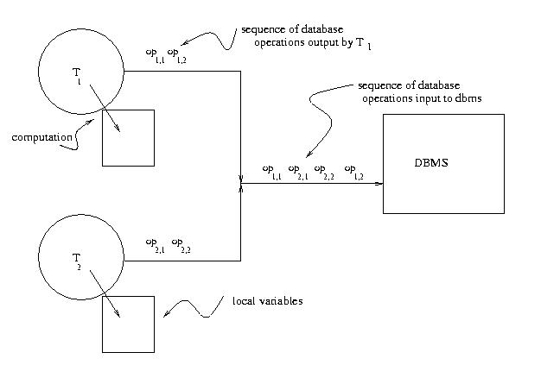
Concurrent Transaction Execution

Slide 8
Transaction Concept
A transaction is a unit of program execution that accesses and possibly updates various data items.
E.g. transaction to transfer $50 from account A to account B:
1. read(A)
2. A := A – 50
3. write(A)
4. read(B)
5. B := B + 50
6. write(B)
Two main issues to deal with:
Failures of various kinds, such as hardware failures and system crashes
Concurrent execution of multiple transactions

Slide 9
Example of Fund Transfer
Transaction to transfer $50 from account A to account B:
1. read(A)
2. A := A – 50
3. write(A)
4. read(B)
5. B := B + 50
6. write(B)
Atomicity requirement
if the transaction fails after step 3 and before step 6, money will be “lost” leading to an inconsistent database state
Failure could be due to software or hardware
the system should ensure that updates of a partially executed transaction are not reflected in the database
Durability requirement — once the user has been notified that the transaction has completed (i.e., the transfer of the $50 has taken place), the updates to the database by the transaction must persist even if there are software or hardware failures.

Slide 10
Example of Fund Transfer (Cont.)
Transaction to transfer $50 from account A to account B:
1. read(A)
2. A := A – 50
3. write(A)
4. read(B)
5. B := B + 50
6. write(B)
Consistency requirement in above example:
the sum of A and B is unchanged by the execution of the transaction
In general, consistency requirements include
Explicitly specified integrity constraints such as primary keys and foreign keys
Implicit integrity constraints
e.g. sum of balances of all accounts, minus sum of loan amounts must equal value of cash-in-hand
A transaction must see a consistent database.
During transaction execution the database may be temporarily inconsistent.
When the transaction completes successfully the database must be consistent
Erroneous transaction logic can lead to inconsistency

Slide 11
Example of Fund Transfer (Cont.)
Isolation requirement — if between steps 3 and 6, another transaction T2 is allowed to access the partially updated database, it will see an inconsistent database (the sum A + B will be less than it should be). T1 T2
1. read(A)
2. A := A – 50
3. write(A) read(A), read(B), print(A+B)
4. read(B)
5. B := B + 50
6. write(B
Isolation can be ensured trivially by running transactions serially
that is, one after the other.
However, executing multiple transactions concurrently has significant benefits, as we will see later.

Slide 12
States of a Transaction
Begin
transaction
Read/Write
End
transaction
Partially
committed
commit
committed
active
abort
abort
rollback
failed
terminated
Active: transaction is started and is issuing reads and writes to the database
Partially committed: operations are done and values are ready to be written to the database
Committed: writing to the database is permitted and successfully completed
Failed: the transaction or the system detects a fatal error
Terminated: transaction leaves the system(Aborted)
Notes:
2
2

Slide 13
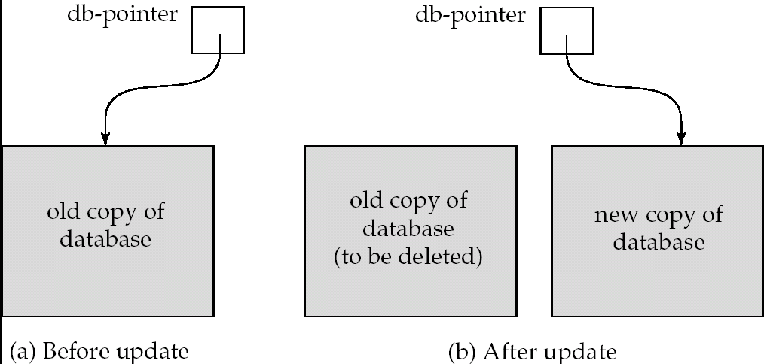
Implementation of Atomicity and Durability
The recovery-management component of a database system implements the support for atomicity and durability.
E.g. the shadow-database scheme:
all updates are made on a shadow copy of the database
db_pointer is made to point to the updated shadow copy after
the transaction reaches partial commit and
all updated pages have been flushed to disk.

Slide 14
Implementation of Atomicity and Durability
db_pointer always points to the current consistent copy of the database.
In case transaction fails, old consistent copy pointed to by db_pointer can be used, and the shadow copy can be deleted.
The shadow-database scheme:
Assumes that only one transaction is active at a time.
Assumes disks do not fail
Useful for text editors, but
extremely inefficient for large databases
Variant called shadow paging reduces copying of data, but is still not practical for large databases
Does not handle concurrent transactions

Slide 15
Concurrent Executions
Multiple transactions are allowed to run concurrently in the system. Advantages are:
increased processor and disk utilization, leading to better transaction throughput
E.g. one transaction can be using the CPU while another is reading from or writing to the disk
reduced average response time for transactions: short transactions need not wait behind long ones.
Concurrency control schemes – mechanisms to achieve isolation
that is, to control the interaction among the concurrent transactions in order to prevent them from destroying the consistency of the database

Slide 16
Schedules
Schedule – a sequences of instructions that specify the chronological order in which instructions of concurrent transactions are executed
a schedule for a set of transactions must consist of all instructions of those transactions
must preserve the order in which the instructions appear in each individual transaction.
A transaction that successfully completes its execution will have a commit instructions as the last statement
by default transaction assumed to execute commit instruction as its last step
A transaction that fails to successfully complete its execution will have an abort instruction as the last statement

Slide 17
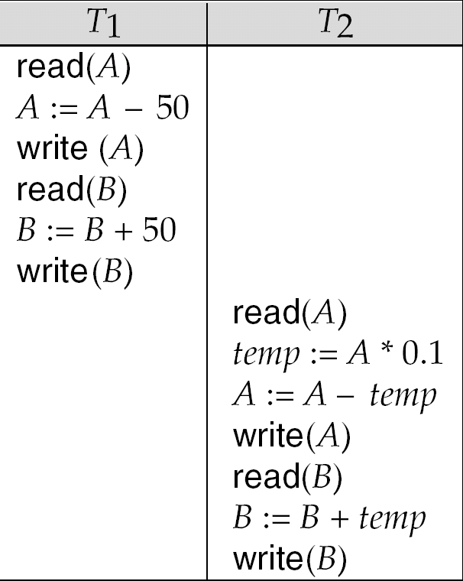
Schedule 1
Let T₁ transfer $50 from A to B, and T₂ transfer 10% of the balance from A to B.
A serial schedule in which T₁ is followed by T₂ :

Slide 18
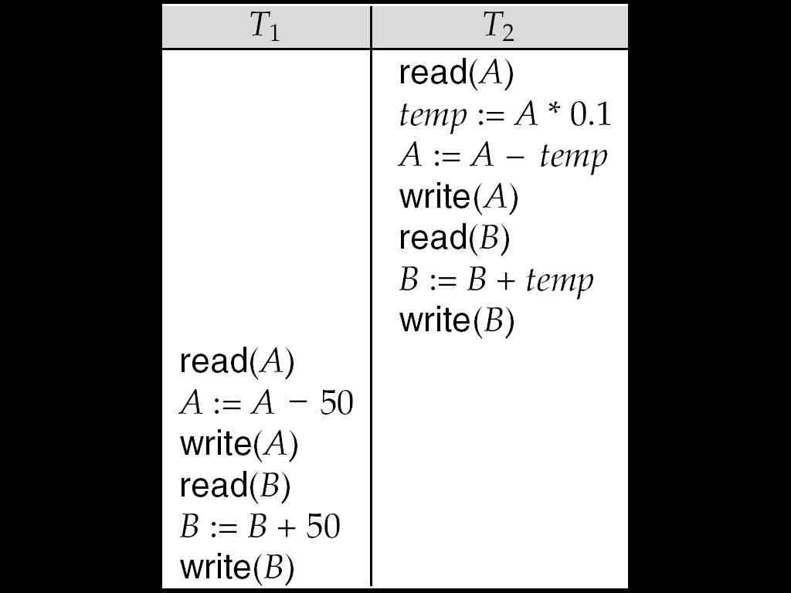
Schedule 2
A serial schedule where T₂ is followed by T₁

Slide 19
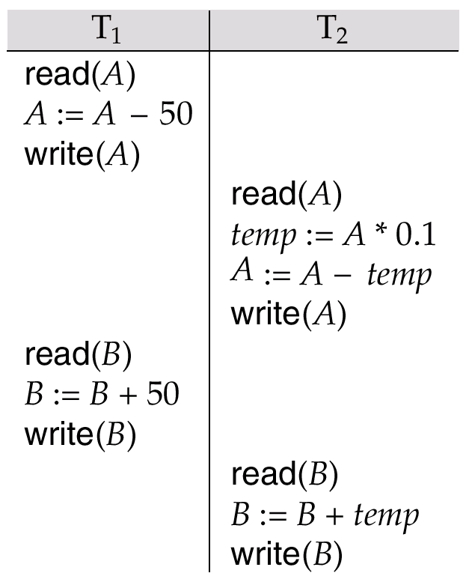
Schedule 3
Let T₁ and T₂ be the transactions defined previously. The following schedule is not a serial schedule, but it is equivalent to Schedule 1.
In Schedules 1, 2 and 3, the sum A + B is preserved.

Slide 20
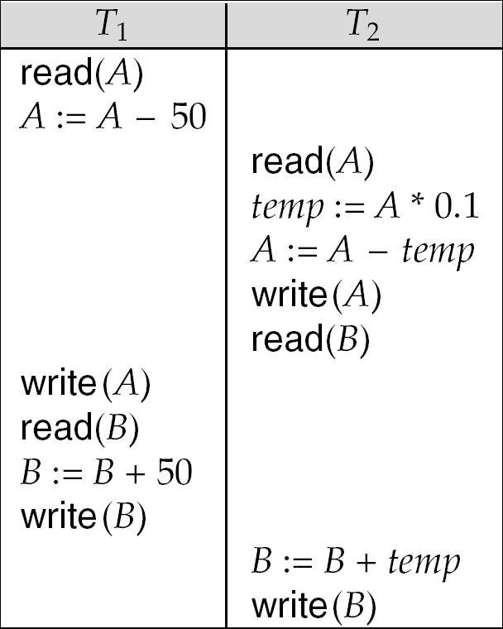
Schedule 4
The following concurrent schedule does not preserve the value of (A + B ).

Slide 21
Serializability
Basic Assumption – Each transaction preserves database consistency.
Thus serial execution of a set of transactions preserves database consistency.
A (possibly concurrent) schedule is serializable if it is equivalent to a serial schedule. Different forms of schedule equivalence give rise to the notions of:
1. conflict serializability
2. view serializability
Simplified view of transactions
We ignore operations other than read and write instructions
We assume that transactions may perform arbitrary computations on data in local buffers in between reads and writes.
Our simplified schedules consist of only read and write instructions.

Slide 22
Serializable Schedules
The concurrent schedule S: r₁(x) w₂(z) w₁(y) is equivalent to the serial schedules of T1 and T2 in either order:
T1, T2: r₁(x) w₁(y) w₂(z) and
T2, T1: w₂(z) r₁(x) w₁(y)
since operations of distinct transactions on different data items commute. Hence, S is a serializable schedule

Slide 23
Serializable Schedules
• The concurrent schedule
S: r₁(z) r₂(q) w₂(z) r₁(q) w₁(y)
is equivalent to the serial schedule T1, T2:
r₁(z) r₁(q) w₁(y) r₂(q) w₂(z)
since read operations of distinct transactions
on the same data item commute. Hence, S is a
serializable schedule
• S is not equivalent to T2, T1 since read and
write operations (or two write operations) of
distinct transactions on the same data item do
not commute

Slide 24
Conflicting Instructions
Instructions l_{i} and l_{j} of transactions T_{i} and T_{j} respectively, conflict if and only if there exists some item Q accessed by both l_{i} and l_{j}, and at least one of these instructions wrote Q.
1. l_{i} = read(Q), l_{j} = read(Q). l_{i} and l_{j} don’t conflict. 2. l_{i} = read(Q), l_{j} = write(Q). They conflict. 3. l_{i} = write(Q), l_{j} = read(Q). They conflict 4. l_{i} = write(Q), l_{j} = write(Q). They conflict
Intuitively, a conflict between l_{i} and l_{j} forces a (logical) temporal order between them.
If l_{i} and l_{j} are consecutive in a schedule and they do not conflict, their results would remain the same even if they had been interchanged in the schedule.

Slide 25
Conflict Serializability
If a schedule S can be transformed into a schedule S´ by a series of swaps of non-conflicting instructions, we say that S and S´ are conflict equivalent.
We say that a schedule S is conflict serializable if it is conflict equivalent to a serial schedule

Slide 26
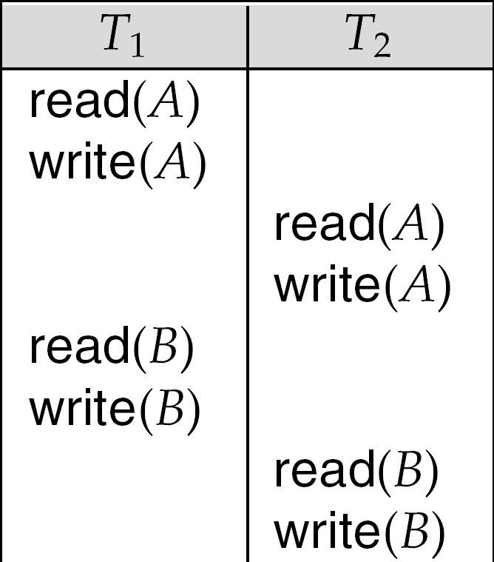
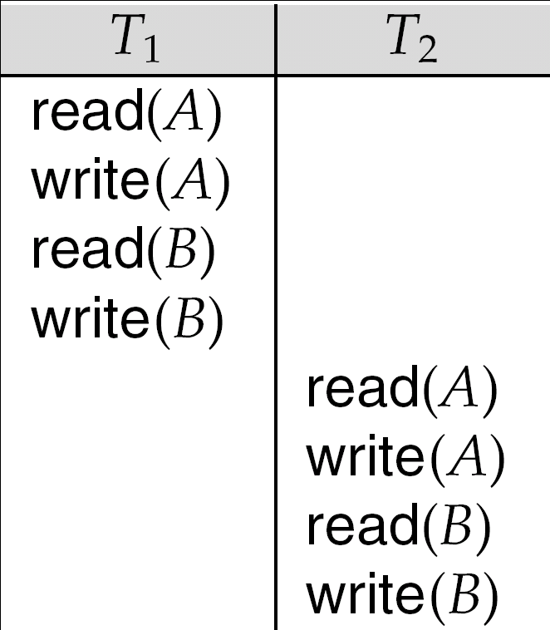
Conflict Serializability (Cont.)
Schedule 3 can be transformed into Schedule 6, a serial schedule where T₂ follows T₁, by series of swaps of non-conflicting instructions.
Therefore Schedule 3 is conflict serializable.
Schedule 3
Schedule 6

Slide 27
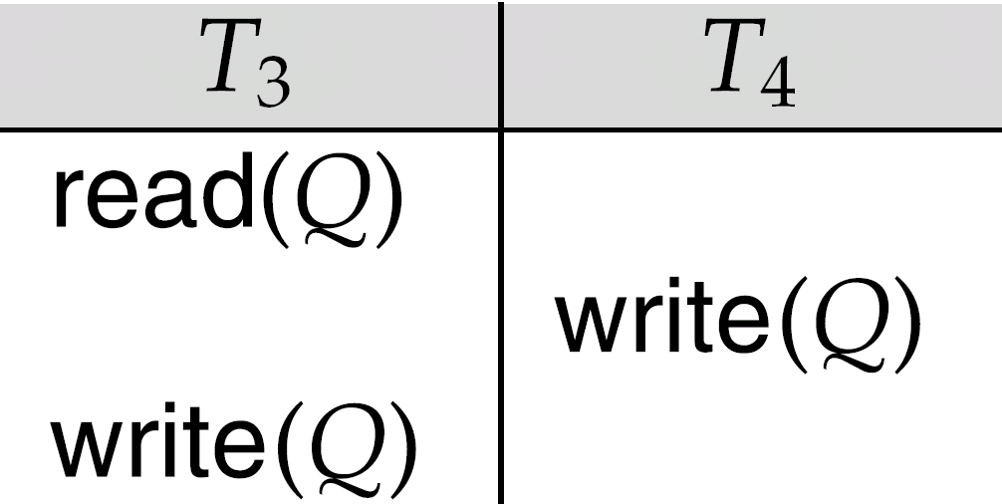
Conflict Serializability (Cont.)
Example of a schedule that is not conflict serializable:
We are unable to swap instructions in the above schedule to obtain either the serial schedule < T₃, T₄ >, or the serial schedule < T₄, T₃ >.

Slide 28
Serializability
Criterion for correctness of concurrency
In other words, criterion for correctness of interleaved schedules
A schedule is correct, ie, serializable, if it is EQ. to some serial schedule
T1 then T2; result x
T2 then T1; result y
Both are considered correct!

Slide 29
Conflicting Instructions
Two consecutive actions of different txs. Are said to be in conflict in an interleaved schedule if:
They involve the same DI
Atleast one of them is a write
Conflicting actions cannot be swapped
Non-conflicting actions can be swapped
Do you agree?
Because swapping them does not change the state of the DB

Slide 30
Conflict Serializability
Take any schedule and make as many NC swaps as we wish, with the goal of turning the schedule into a serial schedule
If we can do so, then the original schedule is serializable
Conflict Serializability is a sufficient condition for serializability
Conflict Serializability => Serializability

Slide 31
Why is Concurrency Control Needed?
Several problems occur when concurrent transactions execute in an uncontrolled manner
A schedule of concurrent transactions is a particular sequence of interleaving of their read or write operations
In general a transaction, has a set of data items it accesses (read set), and a set of data items it modifies (write set)
Notes:
2
2

Slide 32
Problem 1: Lost Update Problem
A transaction overwrites a data item modified by other transactions
Transaction 1 (UCO ATM)
R1(Balance)
Balance=Balance + 500
W1(Balance)
Transaction 2 (SBBJ ATM)
R2(Balance)
Balance=Balance - 700
W2(Balance)
Schedule 1 Balance
R1(Balance) 1000
R2(Balance) 1000
W1(Balance) 1500
W2(Balance) 300
Schedule 2 Balance
R1(Balance) 1000
R2(Balance) 1000
W2(Balance) 300
W1(Balance) 1500
The correct (consistent) value of Balance is 800, when initial Balance is 1000
Notes:
2
2

Slide 33
Problem 2: Dirty Read
A transaction reads uncommitted modified data item values updated by other transactions.
Transaction 1 (UCO ATM)
R1(Balance)
Balance=Balance + 500
W1(Balance)
Abort
Transaction 2 (SBBJ ATM)
R2(Balance)
Balance=Balance -1200
W2(Balance)
Commit
Schedule
R1(Balance) 1000
W1(Balance) 1500
R2(Balance) 1500
W2(Balance) 300
Abort T1
Commit T2 300
T2 read a “dirty value” from T1
For a consistent database state, Transaction 2 should also be aborted
Notes:
2
2

Slide 34
Problem 3: Incorrect Summary
A transaction reads partially updated data item values from other transactions
Transaction 1 (UCO ATM)
R1(Balance2)
Balance2=Balance2 - 500
W1(Balance2)
R1(Balance1)
Balance1=Balance1+500
W1(Balance1)
Transaction 2 (SBBJ ATM)
R2(Balance2)
R2(Balance1)
Sum=Balance1+Balance2
Schedule Bal2 Bal1
R1(Balance2) 2000 1000
W1(Balance2) 1500
R2(Balance2) 1500
R2(Balance1) 1000
R1(Balance1) 1000
W1(Balance1) 1500
The correct sum calculated by T2 should be 3000
Notes:
2
2

Slide 35
Scheduling Transactions
Serial schedule: Schedule that does not interleave the actions of different transactions.
Equivalent schedules: For any database state, the effect (on the set of objects in the database) of executing the first schedule is identical to the effect of executing the second schedule.
Serializable schedule: A schedule that is equivalent to some serial execution of the transactions.
(Note: If each transaction preserves consistency, every serializable schedule preserves consistency. )

Slide 36
Commutativity
Two operations commute if, when executed in either order:
The values returned by both are the same and
The database is left in the same final state
Two schedules are equivalent if one can be derived from the other by a series of simple interchanges of commutative operations
A schedule is serializable if it is equivalent to a serial schedule

Slide 37
View Serializability
Let S and S´ be two schedules with the same set of transactions. S and S´ are view equivalent if the following three conditions are met, for each data item Q,
If in schedule S, transaction T_{i} reads the initial value of Q, then in schedule S’ also transaction T_{i} must read the initial value of Q.
If in schedule S transaction T_{i} executes read(Q), and that value was produced by transaction T_{j} (if any), then in schedule S’ also transaction T_{i} must read the value of Q that was produced by the same write(Q) operation of transaction T_{j} .
The transaction (if any) that performs the final write(Q) operation in schedule S must also perform the final write(Q) operation in schedule S’.
As can be seen, view equivalence is also based purely on reads and writes alone.

Slide 38
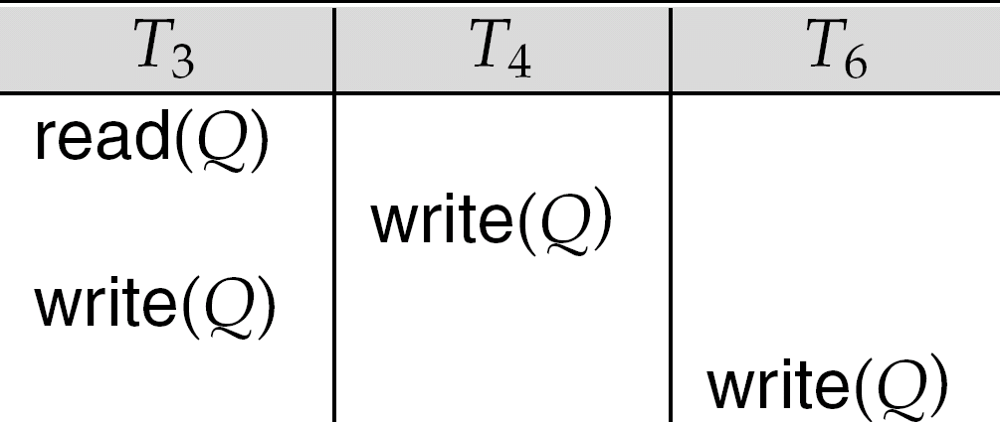
View Serializability (Cont.)
A schedule S is view serializable if it is view equivalent to a serial schedule.
Every conflict serializable schedule is also view serializable.
Below is a schedule which is view-serializable but not conflict serializable.
Every view serializable schedule that is not conflict serializable has blind writes.

Slide 39
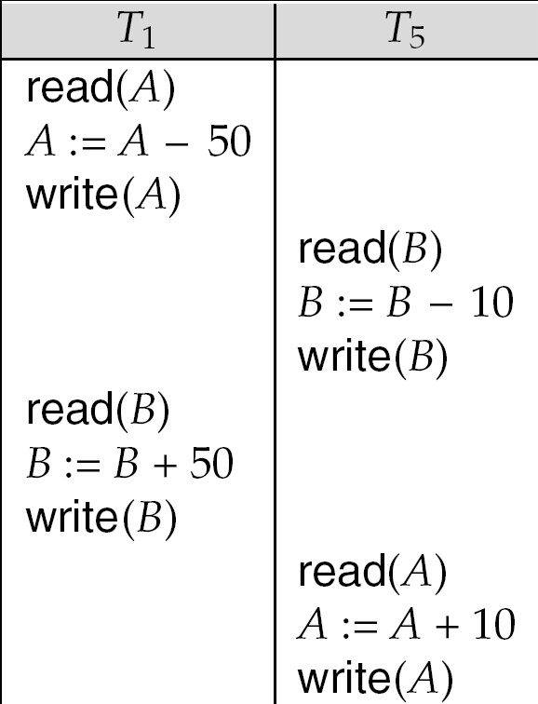
Other Notions of Serializability
The schedule below produces same outcome as the serial schedule < T₁, T₅ >, yet is not conflict equivalent or view equivalent to it.
Determining such equivalence requires analysis of operations other than read and write.

Slide 40
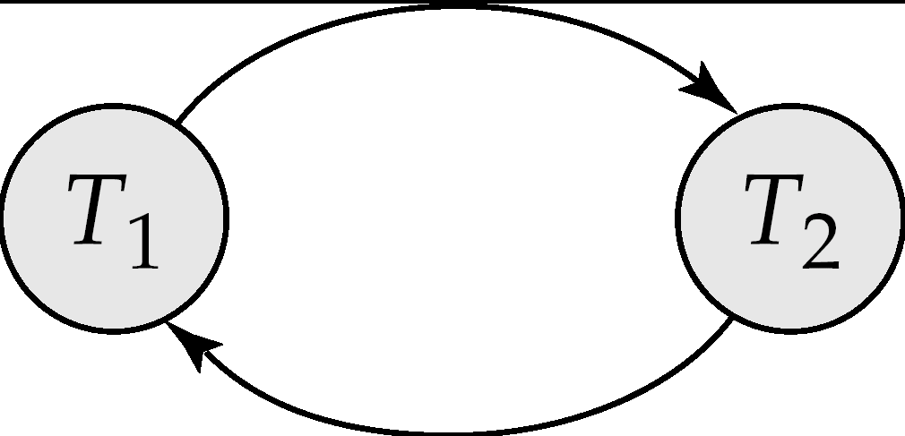
Testing for Serializability
Consider some schedule of a set of transactions T₁, T₂, ..., T_{n}
Precedence graph — a direct graph where the vertices are the transactions (names).
We draw an arc from T_{i} to T_{j} if the two transaction conflict, and T_{i} accessed the data item on which the conflict arose earlier.
We may label the arc by the item that was accessed.
Example 1
x
y

Slide 41
Example Schedule (Schedule A) + Precedence Graph
T₁ T₂ T₃ T₄ T₅ read(X) read(Y) read(Z) read(V) read(W) read(W) read(Y) write(Y) write(Z) read(U) read(Y) write(Y) read(Z) write(Z)
read(U) write(U)
T₁
T₂
T₄
T₃
T₅

Slide 42
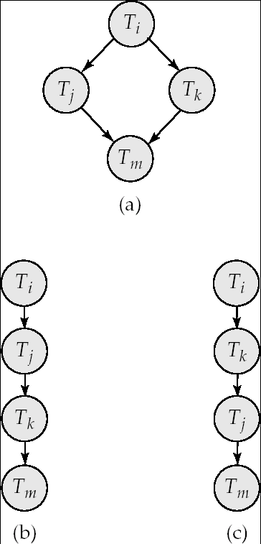
Test for Conflict Serializability
A schedule is conflict serializable if and only if its precedence graph is acyclic.
Cycle-detection algorithms exist which take order n² time, where n is the number of vertices in the graph.
(Better algorithms take order n + e where e is the number of edges.)
If precedence graph is acyclic, the serializability order can be obtained by a topological sorting of the graph.
This is a linear order consistent with the partial order of the graph.
For example, a serializability order for Schedule A would be T₅ → T₁ → T₃ → T₂ → T₄
Are there others?

Slide 43
Test for View Serializability
The precedence graph test for conflict serializability cannot be used directly to test for view serializability.
Extension to test for view serializability has cost exponential in the size of the precedence graph.
The problem of checking if a schedule is view serializable falls in the class of NP-complete problems.
Thus existence of an efficient algorithm is extremely unlikely.
However practical algorithms that just check some sufficient conditions for view serializability can still be used.

